Slide 1


Oracle ASM Training
Oracle ASM Training
By
Vally Cardoza
Jim Stolzenfeld

Slide 2

About Us
2
Who Are We?
Founded | 1997
Financial Profile | Privately Held
Headquarters | Troy, Michigan
Services | Vigilant Technologies is a premier provider of Enterprise Application Management Services with Complete database administration
Support Centers | Troy, Michigan, Toronto, Canada, Hyderabad, India
Employees | Currently 65 & growing

Slide 3
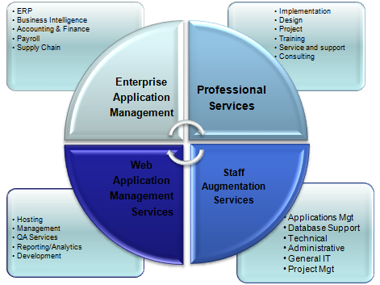
Our Service Offerings
Enterprise Application Management
Oracle E-Business & SAP Managed Services
Database Managed Services
Professional Services
Performance Auditing and Analysis
Consulting
Implementation
Upgrades
Projects
Staff Augmentation Services
Contract Positions
Contract To Hire
Permanent Placements
Web Application Services
Hosting
Management
QA Testing
Analytic Reporting

Slide 4

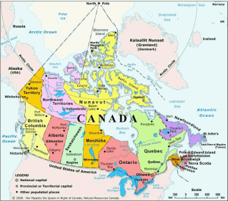
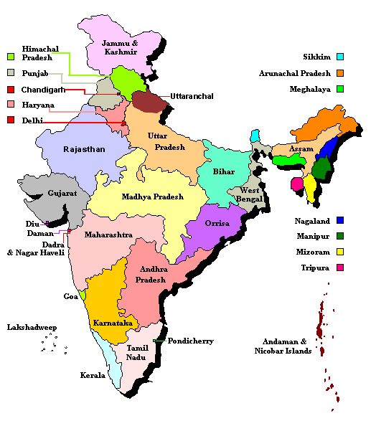
Office Locations
UNITED STATES
Michigan - (Headquarters) 3290 W Big Beaver Rd Suite 310, Troy Michigan. 48084. tel: 248-614-2500 fax: 248 404-9805
Georgia 2020 Airport Industrial Park, Drive, Marietta, Georgia. 30060. tel: 770-404-9800 fax:770-404-9800
CANADA
5925 Airport Rd, Suite 200 Mississauga L4V 1W1. tel: 905 405-6320 fax: 905 248-3502
INDIA
Plot No: 23/A, Flat No: 202,Sai Sushma Homes,SR Nagar, Hyderabad - 500038. tel: 040-64581999

Slide 5
Oracle 10G ASM

Slide 6
Agenda
Database Concepts
ASMLib
ASM
ASM Best Practices
ASM Management
ASM Troubleshooting
Migrating database to ASM
Orion Tool
11g ASM new features
Q/A

Slide 7
Database Concepts
Database Concepts
Database Architecture
Storage Architecture (Logical)
Storage Architecture (Physical)
Storage Requirements

Slide 8
Database Architecture
Collection of system elements
Shared Memory
Concurrency is maintained by locks/latches
Message passing between processes
DBWR (Database writer)
LGWR (Log Writer)

Slide 9
Database Architecture
User process
User process
User process
Server process
Server process
Server process
Process monitor process
Buffer pool
Shared memory
Query plan cache
Lock Manager process
Log buffer
Lock table
Log Writer process
Database Writer process
Checkpoint process
Log disks
data disks
data disks

Slide 10
Storage (Logical)
Tablespaces
Segments
Data segment
Index segment
Temporary segment
Rollback segment
Extents
Oracle data blocks

Slide 11
Storage (Physical)
Database
System Tablespace
Data Tablespace
Table
Index
Table
Table
Table
Index
Table
Table
Index
Index
Index
Table
Index
DBFILE1
DBFILE2
DBFILE3
Drive 1
Drive 2

Slide 12
File Types
File Types
Oracle binaries ( ASM and RDBMS home)
Database files
Datafiles
Control files
Redo log files
Archived log files
Backup files
Database external files – bfiles, external tables
Application related files
Clusterware files – OCR (Oracle Cluster Registry) and Vote disks
Server Initialization files ( SPFILEs)
Notes:
Database files, here the logical storage objects are mapped to the physical objects

Slide 13
Storage Requirements
Local Filesystems /NAS/NFS
Oracle binaries
Application related files
Database files
SPFILES(RDBMS & ASM)
Cluster FS (OCFS)
Oracle binaries
Application related files
Oracle Clusterware devices
Database files
SPFiles (RDBMS & ASM)
Raw/Block devices
Database files
SPFILES (RDBMS & ASM)
Oracle Clusterware devices
ASM
Database files
SPFILES (RDBMS)
Notes:
Spfiles for ASM cannot be put in ASM due to chicken-n-egg situation

Slide 14
ASM
What is ASM
Volume Manager and file system built into Oracle Kernel
File system with raw disk performance
Eliminates need for third-party volume manager and file system for Oracle datafiles
Usable for non-RAC and RAC databases alike
Can be run over LVM
(not recommended)

Slide 15
ASMLIB
An API developed by Oracle to:
Simplify the operating system to database interface
Exploits the capabilities and strengths of vendors’ storage array
Alternative interface for the ASM enabled kernel to identify and access block devices
3rd party vendors would write ASMLIB libraries for their array
Oracle distributes an Oracle ASMLIB for Linux only (free add-on to ASM)

Slide 16
ASMLIB
Reduced Overhead
Globally manages all disk file descriptors for ASM [RAC]
Disk Management and Discovery
Automatic disk discovery
ASM_DISKSTRING need not be set I ASM detects ASMLIB or set to ‘ORCL:*’
Device name persistence across all nodes in a cluster
Automatic ASM disk naming
Obviates the need for raw devices
I/O Processing
One call to ASMLIB can submit & reap multiple I/O’s, reducing the number of calls to OS – context switches.
Performs async I/Os via internal calls
Notes:
16

Slide 17
ASMLIB Installation & Conf
Consists of three rpms:
oracleasm-support-2.0.1-1.i386.rpm
oracleasmlib-2.0.1-1.i386.rpm
oracleasm-2.6.9-34.ELsmp-2.0.1-1.i686.rpm
Download the ASMLib software from the OTN website
Notes:
17

Slide 18
ASMLIB Installation & Conf
Install the packages as the root user
# rpm –Uvh oracleasm-support-2.0.1-1.i386.rpm \ oracleasmlib-2.0.1-1.i386.rpm \ oracleasm-2.6.9-34.ELsmp-2.0.1-1.i686.rpm
Notes:
18

Slide 19
ASMLIB Installation & Conf
Configuring the Oracle ASM library driver. It will configure the on-boot properties for it.
#/etc/init.d/oracleasm configure
Response required
Default user
Default group
Start Oracle ASM library on boot
Fix permissions of Oracle ASM disks on boot
Notes:
19

Slide 20
ASMLIB Installation & Conf
Once ASMLIB is installed and configured. Once ASM is restarted, ASM will dynamically discover that ASMLIB is loaded
All disk discovery and IO calls are handled through ASMLIB
After ASM initialization you’ll see the following message in the ASM log:
Loaded ASM library – Generic Linux version 1.0.0 library for asmlib interface
Notes:
20

Slide 21
ASMLIB - Creating disks
Once the kernel module is loaded, stamp (or label) the partitions created earlier as ASM disks
#/etc/init.d/oracleasm createdisk VOL1 /dev/sdb1 ( Marking disk “/dev/sdb1” as an ASM disk
If RAC installation, on the other nodes
#/etc/init.d/oracleasm scandisks
# /etc/init.d/oracleasm listdisks
displays VOL1
Notes:
21

Slide 22
Lab 1 : Configuration of devices for ASM
Lab 2 : Install and Configure ASMLIB

Slide 23
I/O Distribution
ASM implements Stripe and Mirror Everything ( SAME)
Spreads file AUs evenly across disks in Disk Group
Evenly spreads space usage and I/O across disks
Removes need for manual tuning
Allows online storage reconfiguration
Since ASM distributes extents evenly, there are no hot spots
Notes:
In unstriped disk I/O, one or more disks can have all the data, whereas in striped disk I/O the data is evenly spread among the disks

Slide 24
ASM Placement in the Storage Stack
Applications
Database
ASM
Operating System
Storage System

Slide 25
ASM Operational Stack
Tables
Tables
Tablespace
Tablespace
Files
Files
File System
File System
ASM
Logical Vol
Logical Vol
Disks
Disks Group
Networked Storage (SAN , NAS)

Slide 26
Storage and ASM administration
SYS Admin Role
Pre-Installation
Create LUNs
Set Ownership and permissions to Oracle user
ASM Admin Role
Installation
Oracle Universal Installer (OUI)
Conf Assistants
Create disk groups
Normal Operation
Monitor capacity and availability
Provision capacity

Slide 27
ASM Reduces Mgmt Complexity
Eliminates
LVM mgmt for Oracle DB
File system mgmt for Oracle DB
Cluster FS and RAW mgmt
File name mgmt
Reshuffling, reallocating moving datafiles
I/O performance tuning
Reduce significantly
LUN mgmt (larger LUNs)
Less frequent DBA and sys admin interaction
Manual error prone tasks
Troubleshooting
Expanding Capacity

Slide 28
Traditional LVM/FS vs ASM Add Capacity
LVM/FS
Add Disk to O/S
Create volume(s) with Volume Manager
Create File System over volume
Figure out data to move to new disk
Move data to new files
Rename files in database
Re-tune I/O
ASM
Add Disk to O/S
Add Disk to a disk group

Slide 29
ASM Process Architecture
DB Instance
Non-RAC Database
ASM Instance
Server
Pool of Storage
Disk Group
Disk Group

Slide 30
ASM Architecture Storage and Data Objects
Allocation Units
ASM Disks
Disk Groups
External redundancy
ASM redundancy
ASM Files
Extent Maps
Rebalance

Slide 31
Allocation Units
ASM Disks are divided into Allocation Units
Default allocation unit size is 1MB
In 11g – configurable at diskgroup creation
1 MB Allocation Units small enough to be cached by database and large enough for efficient sequential access
Files are a collection of Allocation Units
Analogous to extents in filesystems

Slide 32
ASM Disk
Object of persistent storage for a Disk Group
Accessed through normal OS interfaces
Needs to be read/write accessible by Oracle user
Accessible to all nodes in a cluster
May have different names on different nodes
Path names not stored on disk
Object that is protected using ASM redundancy
Files evenly distributed across disks in a Disk group

Slide 33
Striping Granularity
ASM separates striping for load balance and striping for latency
Coarse grained striping concatenates virtual extents
Fine grain striping puts 128K stripe units across groups of 8 virtual extents for latency
Notes:
Fine grain is good for small I/O operations hence redo log writes

Slide 34
Disk Header Info
Disk Header defines ASM Disk
Block zero of every ASM Disk
ASM Disk name and number
Time stamp of creation
Houses ASM metadata
File directory
Allocation table and Free space table

Slide 35
Disk Discovery
ASM Instance
Has a bootstrap file called init.ora/spfile.ora
ASM_DISKSTRING=/dev/rdsk/*
ASM_DISKGROUP=‘DATA’,’FRA’
Display discovered disks
Select name, path from V$asm_disk;
asmcmd>lsdsk
Notes:
ASM disk states – Member, Former, Candidate, Provisioned ( same as candidate but additional platform specific action has been taken by the admin to make the disk available for ASM), Foreign, unknown( ASM has not read the disk header yet)

Slide 36
ASM Diskgroup Overview
Highest level object managed by ASM
A collection of ASM disks
Self-describing independent of media name
A file is allocated within a disk group
Multiple databases share multiple disk groups

Slide 37
ASM Diskgroup Types
Disk Groups
External Redundancy
Redundancy Managed by external means; e.g; intelligent storage array
A collection of ASM disks
ASM Redundancy
Redundancy managed and maintained by ASM
Normal – mirroring
High – Triple mirroring

Slide 38
ASM Diskgroup Setup
A walkthrough configuration of a diskgroup
Present LUNs to host
Ensure correct disk permission so that ASM disk discovery will find the provisioned LUNs.
Create diskgroup using the required number of disks:
SQL> create diskgroup DATA external redundancy disks ‘/dev/sda1’,’/dev/sda2’;

Slide 39
External Redundancy
1
2
5
3
4
Five data extent file

Slide 40
External Redundancy
1
2
5
3
4
Five data extent file and One MB fine grained file

Slide 41
ASM Failure Groups
A Disk Group is partitioned into two or more Failure Groups
A Failure Group is a set of disks sharing a common resource whose failure needs to be tolerated
Redundant copies of extents are stored in separate Failure Groups
Failure Groups are specified by DBAs or automatically by ASM
Hardware dictates Failure Group boundaries

Slide 42
ASM Failure Groups
Server
Controller 1
Controller 2
Failure Group 1
Failure Group 2
Disk Groups

Slide 43
Normal Redundancy
Disk A
Disk B
Disk E
Disk F
Disk C
Disk D
Disk G
Disk H
Failure Group 1
Failure Group 2
Empty Disk Groups

Slide 44
Normal Redundancy
Disk A
Disk B
Disk E
Disk F
1
5
4
4
1
Disk C
Disk D
Disk G
Disk H
3
2
2
5
3
Failure Group 1
Failure Group 2
Five MB normal redundancy file
Primary extents in red
Secondary extents in green

Slide 45
Disk Failure
Disk A
Disk B
Disk E
Disk F
1
5
4
4
1
Disk C
Disk D
Disk G
Disk H
3
2
2
5
3
Failure Group 1
Failure Group 2
Disk H Fails

Slide 46
Disk Failure
Disk A
Disk B
Disk E
Disk F
1
5
4
4
3
1
Disk C
Disk D
Disk G
Disk H
3
2
2
5
5
3
Failure Group 1
Failure Group 2
Reconstruct Redundancy

Slide 47
Disk Failure
Disk A
Disk B
Disk E
Disk F
1
5
4
4
3
1
Disk C
Disk D
Disk G
3
2
2
5
Failure Group 1
Failure Group 2
Drop Disk

Slide 48
ASM File
ASM File creation
ASM Instance is registered with CSS (Cluster Synchronizing Service)
Database Process connects directly to ASM instance getting information from CSS
Database requests file creation and blocks for reply
ASM foreground creates Continuing Operation Directory (COD) entry and allocates space for new file across all disks
ASMB receives extent map for new file

Slide 49
ASM File
ASM File creation (cont’d)
Database process initializes file contents
Database process requests commit of file create
ASM foreground clears COD(Continuing Operation Directory) and marks file created
ASMB message to delete extent map closing file
Database process logs out of ASM

Slide 50
ASM File
ASM File Open
Database Process allocates a connection slave
Open request sent to slave and on to ASM foreground
ASM foreground finds file and sends extent map to ASMB
Slave receives successful open and returns it to the database process

Slide 51
Extent Map
Extent Map
Disk A
ASM File
1
4
Disk B
2
Disk C
3
File Address Space

Slide 52
ASM Rebalance
Storage reconfiguration ( add/drop/failure) leads to a need to rebalance
Rebalance is done automatically while Disk Group is online and only one extent is locked at a time
ASM files are equally spread across all disks in a Disk Group
Disk add => Share of file extents from all currently mounted disks are moved to a new disk
Disk drop => File extents on dropped disk evenly moved to remaining disks

Slide 53
Lab 3 : Creating ASM Instance and managing
ASM Disk Groups

Slide 54
ASM Best Practices
ASM Installation
Install ASM in a separate ORACLE_HOME than the database ORACLE_HOME
Provides higher availability and manageability
Allows independent upgrades of the database and ASM
De-installation of database software can be performed without impacting the ASM instance
Disk Best Practices
If using hardware RAID, make sure LUN stripe size is as close to 1mb as possible
Use OS disk labels when possible
Prevents accidental user overwrites of disks
Easier management of disks
Make sure the disk (partition) starts at 1MB a boundary, to ensure proper I/O alignment
With 10.2, one can use block devices for e.g. use /dev/sda1 instead of /dev/raw/raw1

Slide 55
ASM Best Practices
Disk Best Practices
Make sure disks span multiple backend disk adapters
Implement multiple access paths to the storage array using two or more HBAs or initiators
Deploy multi-pathing software over these multiple HBAs to provide I/O load balancing and failover capabilities -- Metalink note 294869.1
Disk group Best Practices
Create two diskgroups, one for database area and another for flash recovery area (no need to separate data from indexes)
Create diskgroups using large number of similar type disks
same size
same performance characteristics
To minimize search overhead, perform all required mount operations in a single mount command
The size of FRA diskgroup will depend on what is stored and how much is retained. The size is driven by recovery time objectives
Notes:
55

Slide 56
ASM Best Practices
Disk group Best Practices
Use ASM external redundancy when using high-end storage arrays
Use ASM redundancy for low-end(modular) or JBOD storage array systems
Use failure groups with ASM redundancy,
Determine what failure components your are protecting yourself from.
Rebalance Best Practices
If adding or removing multiple disks, make the change in a single rebalance operation
This coalesces rebalance operations and reduces overhead
Make sure enough CPU and IO resources are available for rebalance operation
Use ASM power level of 5
Check to make sure a diskgroup is not left in a “unbalanced” state
Notes:
JBOD- Just a Bunch of disks
56

Slide 57
ASM Best Practices
Database-ASM Best Practices
Use Oracle Management File (OMF)
Easier Oracle file management
Reduces user file management errors
Enforcement of OFA standards
Automatic deletion of ASM files when database files are dropped
To use OMF set:
db_recovery_file_dest=‘+FLASH’
db_create_file_dest=‘+DATA’
The following recommendations for database SGA sizing can be used to calculate the SGA_TARGET value (Recommended to use 10G AMM automatic memory mgmt)
large_pool = Add additional 600k
processess= 16
Notes:
57

Slide 58
ASM Best Practices
Database-ASM Best Practices
Shared_pool parameter
Find out how much data will be stored in ASM
For diskgroups using external redundancy = (Every 100GB of space needs 1MB of extra shared pool) + 2M
For diskgroups using Normal redundancy = (Every 50GB of space needs 1MB of extra shared pool) + 4M
For diskgroups using High redundancy = (Every 33GB of space needs 1MB of extra shared pool) + 6M
ASM init.ora parameter
processes = 25 + Add 15 per database connected to ASM
Notes:
58

Slide 59
ASM Management
SQLPLUS
DBCA (Database Configuration Assistant)
Enterprise Manager
asmcmd – command line access to ASM
Notes:
59

Slide 60
ASM Management
SQLPLUS
Create/Drop disk group
Create diskgroup DATA external redundancy disk ‘ORCL:*’;
Alter Disk group
Alter diskgroup DATA ADD/DROP/RESIZE disk..
Alter diskgroup DATA add ..rebalance power {0|11};
Alter diskgroup DATA MOUNT/DISMOUNT ..
Alter diskgroup DATA ADD/ALTER/DROP TEMPLATE ..
Alter diskgroup DATA DROP FILE/DIRECTORY/ALIAS ..
Alter diskgroup DATA check all repair; Checks inconsistency of diskgroup metadata
ASM diskgroup and Disk v$ASM views
Select all v$asm_* views
Notes:
Direcory are created so that alias can reside
60

Slide 61
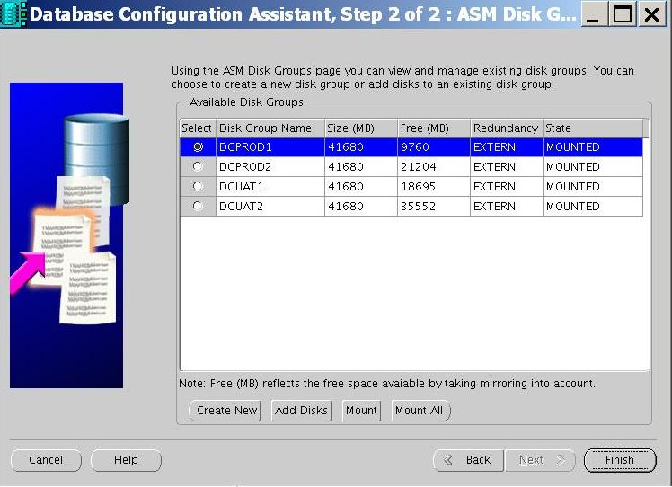
ASM Management
DBCA
Notes:
61

Slide 62
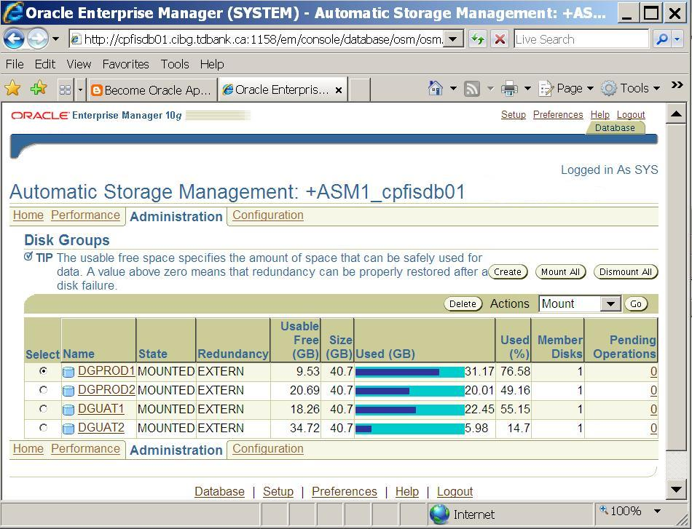
ASM Management
Enterprise Manager
Notes:
62

Slide 63
ASM Management
asmcmd
lsct – list all the connected clients – from v$asm_client
lsdg – list the diskgroup from v$asm_diskgroup
du, ls, mkdir, pwd, rm, rmalias
Notes:
63

Slide 64
ASM Troubleshooting
ASM Startup fails
Make sure CSS is started and running in the correct mode
CSS should be started from the ASM home in single-instance setups and from the CRS home in cluster setup
Make sure enough memory is available for ASM
Notes:
64

Slide 65
ASM Troubleshooting
ASM trace files
Each ASM instance has trace directory
Alert.log
Notes:
65

Slide 66
ASM Troubleshooting
ASM Disk Discovery
Can’t discover disks
Check to see if the asm_diskstring parameter matches the desired disk path
Make sure that the device is both readable and writable by ASM
Make sure that the device is on an OS partition rather than on the raw disk itself; i.e., it should not include the partition that contains the VTOC.
Notes:
VTOC- volume table of content
66

Slide 67
ASM Troubleshooting
ASM Disk Discovery
Can’t discover disks
If using ASMLIB
Ensure ASMLIB listdisks lists all required disks
Make sure that ASMLIB scandisk returns with <OK>
Verify the correct library-specific discovery string is used; i.e. it should be “ORCL:*”
ORA-15020: discovered duplicate ASM disk
Asm_diskstring resolves to duplicate paths
If using multipathing tools, specify the virtual device, or a single path
Notes:
67

Slide 68
ASM Troubleshooting
Diskgroup Issues
Disk group out of space despite added storage
Make sure that all ASM devices are of similar capacity, including the ones being added
If failgroups contain more than one device, make sure that the total capacity of each failgroup is similar across all failgroups.
If rebalance hangs because there is no more space available
Then add more storage of similar size
Make sure that the asm_power_limit parameter is not set to zero
Notes:
V$ASM_OPERATION for rebalance operation
68

Slide 69
ASM Troubleshooting
Diskgroup Issues
Unexpected Disk group dismount
WARNING: offlining mode 3 of disk 1/0x0( DATA_1_0001)
Indicates that there was an I/O error to a particular disk
ERROR: PST-initiated MANDATORY DISMOUNT of group DATA_1
Indicates that trying to take the disk offline would have caused data loss, so ASM is dismounting the disk group instead.
In both cases look for disk I/O errors from OS and storage layers
Notes:
69

Slide 70
ASM Troubleshooting
Recovering from Transient disk failures
For ASM redundancy diskgroups, there may be cases where disks temporarily lose connectivity or have transient failures
V$ASM_DISK query shows this for a disk:
NAME MOUNT_STATUS STATE
--------- ----------------------- --------
DATA MISSING HUNG
Ensure you’ve recovered from transient failure, v$asm_disk will now show a MEMBER disk
Add disks back in the diskgroup using the alter diskgroup add disk and specifying the FORCE option
Notes:
70

Slide 71
ASM Troubleshooting
Database Connections
Symptom: Database unable to connect to ASM instance.
ASM instance is not running or has not mounted the diskgroup
DB user is not in the primary member of CSS group
Symptom: Subsequent Database mount cannot find the controlfile
Check that ASM instance is running and has mounted the diskgroup
If OMF was used to create the controlfile then one needs to create an alias for the OMF file and update the parameter file
Notes:
71

Slide 72
ASM Troubleshooting
Database Connections
Symptom: Database does not startup due to errors in spfile stored in a diskgroup
Copy the spfile out of the diskgroup to a local filesystem using create pfile from spfile=‘+dg/spfile.ora’
Notes:
72

Slide 73
ASM Troubleshooting
Memory Related Issues (Shared pool, Large Pool, Cache Size, etc)
Increase respective memory size, based on the suggestions made earlier
Note that the memory requirements for the database and the ASM instances are different
Notes:
73

Slide 74
Migrating DB to ASM
Migrating from non-ASM to ASM
rman utility
DBMS_FILE_TRANSFER API
Enterprise Manager which in turn uses RMAN
Notes:
74

Slide 75
Orion Tool
Oracle Input Output Number
Measuring I/O of the storage using ORION
Not supported by Oracle
Notes:
75

Slide 76
Lab 4 : Migrating Database to ASM
Lab 5 : Orion Tool

Slide 77
ASM 11G new features
Re-sync ASM disks after transient failures
Only changed blocks are resync’ed
Alter diskgroup DATA online disk D3_0001;
Alter diskgroup DATA online all;
Benefits
Fraction of time to re-establish redundancy
Enables pro-active maintenance
Fast recovery in extended clusters
Notes:
77

Slide 78
ASM 11G new features
Preferred Read Failure group
Allows local mirror read operations in extended clusters.
Eliminates network latencies
Notes:
78

Slide 79
ASM 11G new features
Rolling upgrade and patching
Maximizes database availability in a cluster (RAC)
How does it work
Place cluster in “Rolling Migration” mode
Bring down ASM on a cluster node
Upgrade or patch ASM software
Re-start ASM (Cluster can operate in mixed ASM version mode while rolling migration mode is on)
Repeat the same for all nodes
Stop ‘Rolling Migration’ mode
Notes:
ALTER SYSTEM START ROLLING MIGRATION TO '11.1.0.7.0';
ALTER SYSTEM STOP ROLLING MIGRATION;
79

Slide 80
ASM 11G new features
Variable Extents
ASM Extent Map
Collection of data extents that defines ASM file
Variable size extents
Extent size grows automatically with file size
Benefits
Reduce memory utilization in SGA
Improved file create/open
Increase maximum ASM file size
100% automatic
Notes:
Note: RDBMS limits file size to 128TB
80

Slide 81
ASM 11G new features
Maximum Allocation Units and Variable extents
Higher performance for large Segment I/O (DW)
Allocation Unit (AU)
Select at disk group creation time and may be 1/2/4/8/16/32/64 MB
Variable size ASM file extents
Extent size = AU size up to 20,000 extents
Extent size = 8*AU up to 40,000 extents
Extent size= 64*AU beyond 40,001 extents
Striping
Coarse Stripe size always = one AU
Fine Stripe size always = 128 KB
Notes:
81

Slide 82
ASM 11G new features
Disk Group Attributes
Maintain ASM and RDBMS compatibility based on requirements
Allow user to try new version before committing
Notes:
82

Slide 83
ASM 11G new features (Disk group attributes)
Name | Values | Description
au_size | 1|2|3|4|16|32|64MB | Size of allocation units in the disk group
disk_repair_time | 0 M to 2³² D | Length of time before removing a disk once OFFLINE
compatible.asm | Valid db version | Set to 11.1 to enable – new ASMCMDs and V$asm_attribute view
compatible.rdbms | Valid db version | Set to 11.1 to enable – Variable size extents, Fast mirror resync, preferred read and AU size > 16MB
Notes:
83

Slide 84
Q & A

